Slide 1
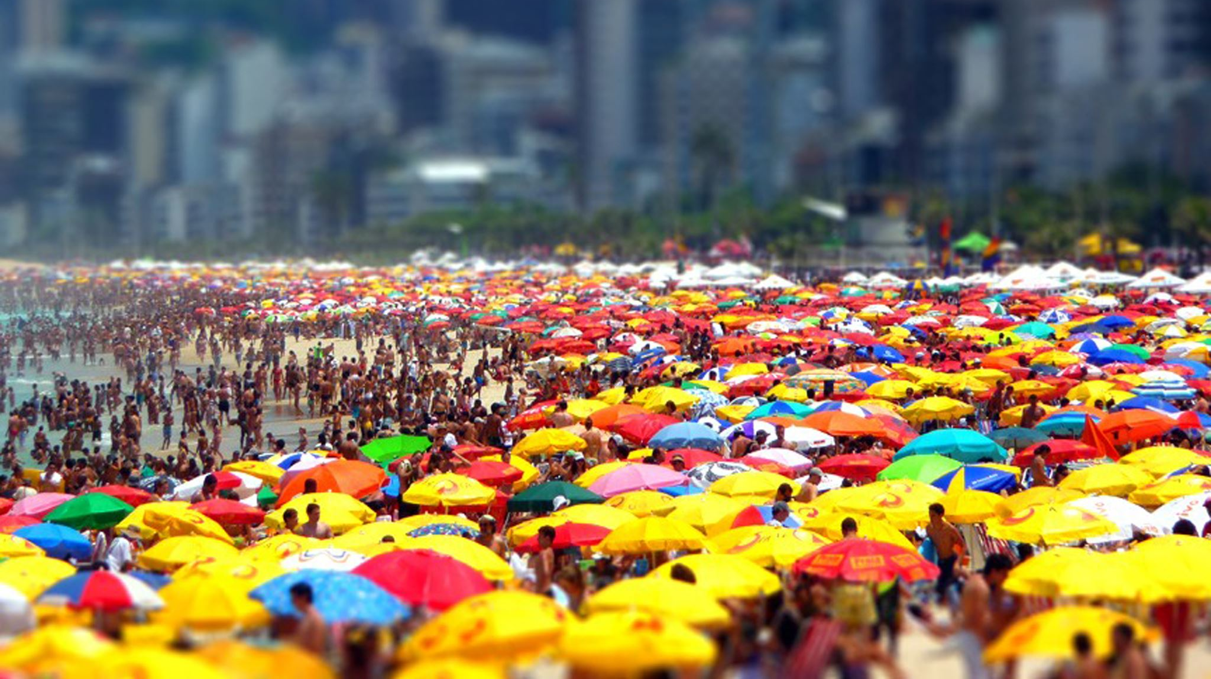
Spring Festival
By Party Animal Co.
Aashutosh Sehgal – 0780170
Devashish Patel – 0781214
Heta Desai – 0783609
Rakesh Singh – 0775942
Rohit Rohit - 0773987

Slide 2
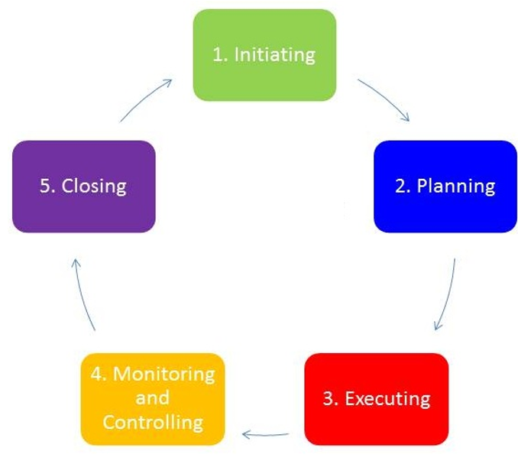
Our Approach to the Project

Slide 3
Project Planning Flow
Project Charter, Scope
Project Communication
Project Schedule
Project Risk
Project Resource
Project Budget & Cost

Slide 4
Project Planning
The planning included the following steps:
Team assembly
Setting Project Objectives and Approximate Guest Limit
Creating Budget & Scope
Finalising Venue & Date
Reach out for Funding (Event Sponsors)
License and Permit Requisitioning
Promotional and Marketing Posts via phone number and social media
Registration of Guests
Entertainment and Food & Drinks Planning
COVID-19 Measures
Security Planning and Check Points

Slide 5

Problem Statement
After facing the brunt of the COVID-19 pandemic for the better part of 3 years, everybody was longing for a stress release.
Almost everyone’s mental health had taken a toll because of the unprecedented situation that had surfaced. This party enabled most of the attendees to get some semblance of a normal life resumed and hit the ground running.

Slide 6
Objective of the Project
This is where our organization Party Animal Co. comes in the picture. Party Animal Co. specializes in organizing parties and such gatherings.
Our organization planned to organize a party for the people of Ontario.
Everybody should enjoy themselves and be able to satiate their food palate as far as possible.

Slide 7
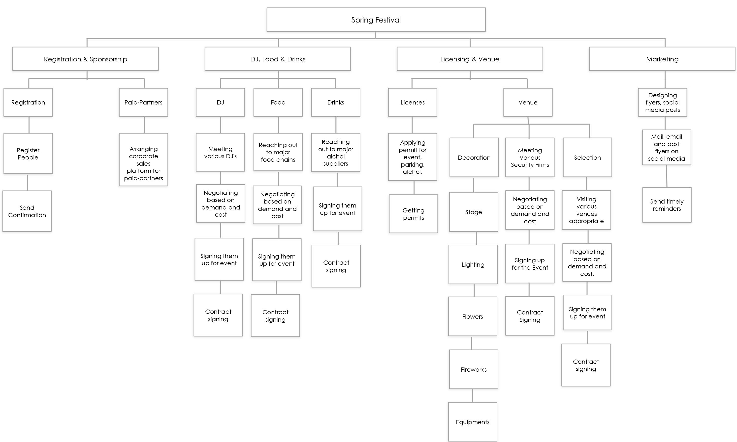
Work Breakdown Structure

Slide 8

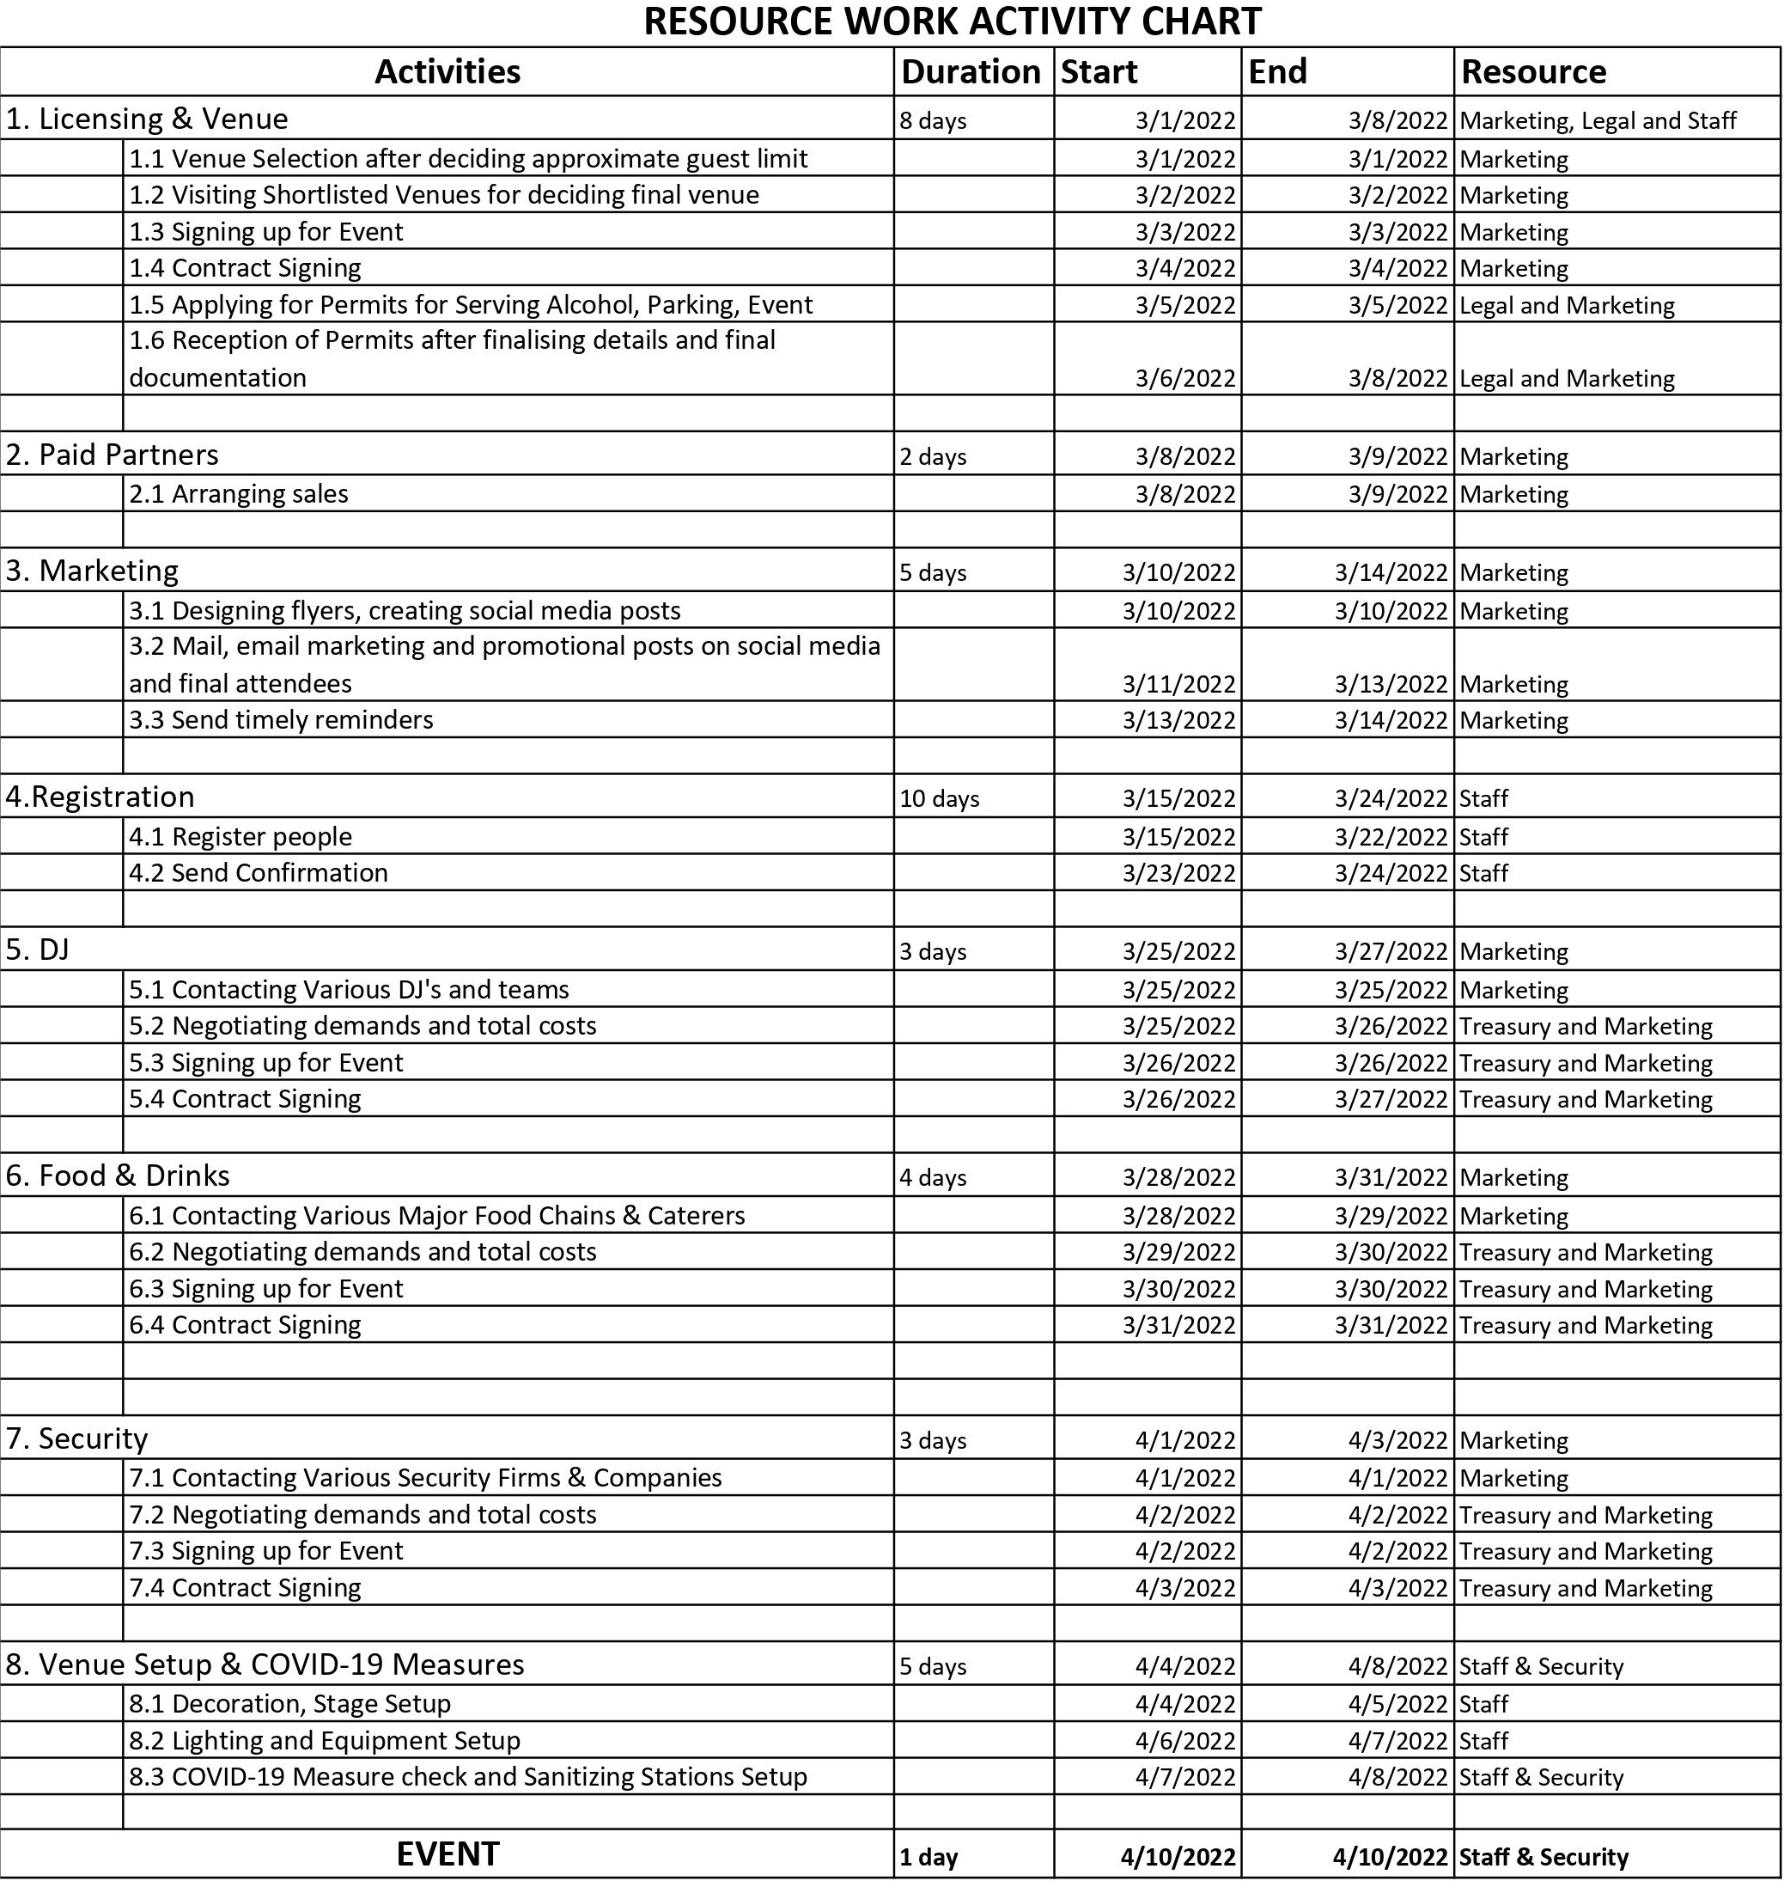
Project Resource & Schedule

Slide 9
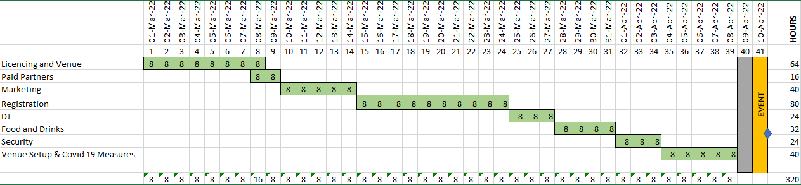
GANTT CHART FOR SCHEDULING

Slide 10


Project Budget & Cost
Estimated Budget for the Project was 170000$.
Cost Variance is 2500$ which is still under budget.
The Balance remaining after all the expenditure is 9000$.

Slide 11
Stakeholders
The stakeholders of our project are shown below.
The key stakeholders of our project are the sponsors and the project managers.
The food, drinks, venue and security partners also played a crucial role in the success of the event.

Slide 12



Project Risks Involved
There were chances of overflow of guests because of lapse in checking and security.
This would have in-turn lead to more costs, not only because more material would be required at the food stalls, but it might even have led to inconveniences in the party crowd.
There were chances of COVID-exposure in the party in the case of guests not following correct COVID protocol and measures.
The Entertainment , Food & Drinks teams might have turned up late because of any number of reasons.
There were chances of many guests not showing up even though they had paid for the event because of not waking up on time or other reasons. This would have led to wastage of food and money.

Slide 13
Project Risks Contd.
Influence of Stakeholders: It is often said too many cooks spoil the pudding. This could have been the case if the project managers and the project sponsor had underestimated the influence of the stakeholders.
Inaccurate Time Management: The initial plan could have turned out to be insufficient in terms of the time required to finish the necessary tasks. This could have led to delay in the plans and maybe even risk postponing the event which would be disastrous in terms of customer satisfaction and also with the budget going over the specified value.

Slide 14
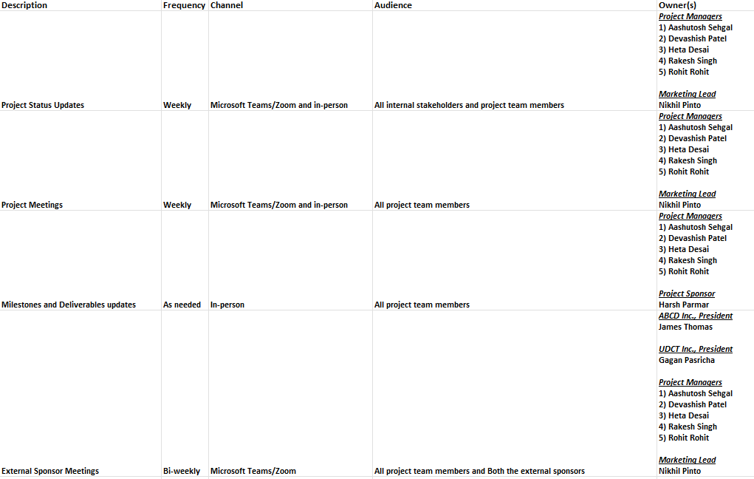
Communication Plan
This is a glimpse of our communication plan.
In our communication plan, we have mentioned how frequently we communicate with our stakeholders and which channel we used to do so.

Slide 15

Monitoring and Controlling
Monitoring and Controlling entails the following tasks:
Time Management: Using Resource work activity chart
Cost Management: Using Business Case Budget Description
Quality Assessment: We instructed all our staff to follow all quality standards and protocols.
Change Management: We used appropriate change request forms and updated the change log accordingly.
Risk Management: We identified all possible risks and allocated a reserve fund of 9000$ for any risk mitigation.
Communication Management: We used stakeholder register and a communication plan to communicate efficiently and effectively.
Acceptance Management: We matched our requirements with project charter regularly.
Procurement Management: We collaborated with the best contractors in the business.

Slide 16
Closing
The Closing of our event was marked by its grand success. The following was also achieved:
We finished the event payments under the budget.
The event had a great turnout of approximately 970 guests.
There were no security issues or concerns for the entirety of the event.
We did not face any COVID-19 exposure.
The event was a total hit for all our sponsors and their clients.

Slide 17

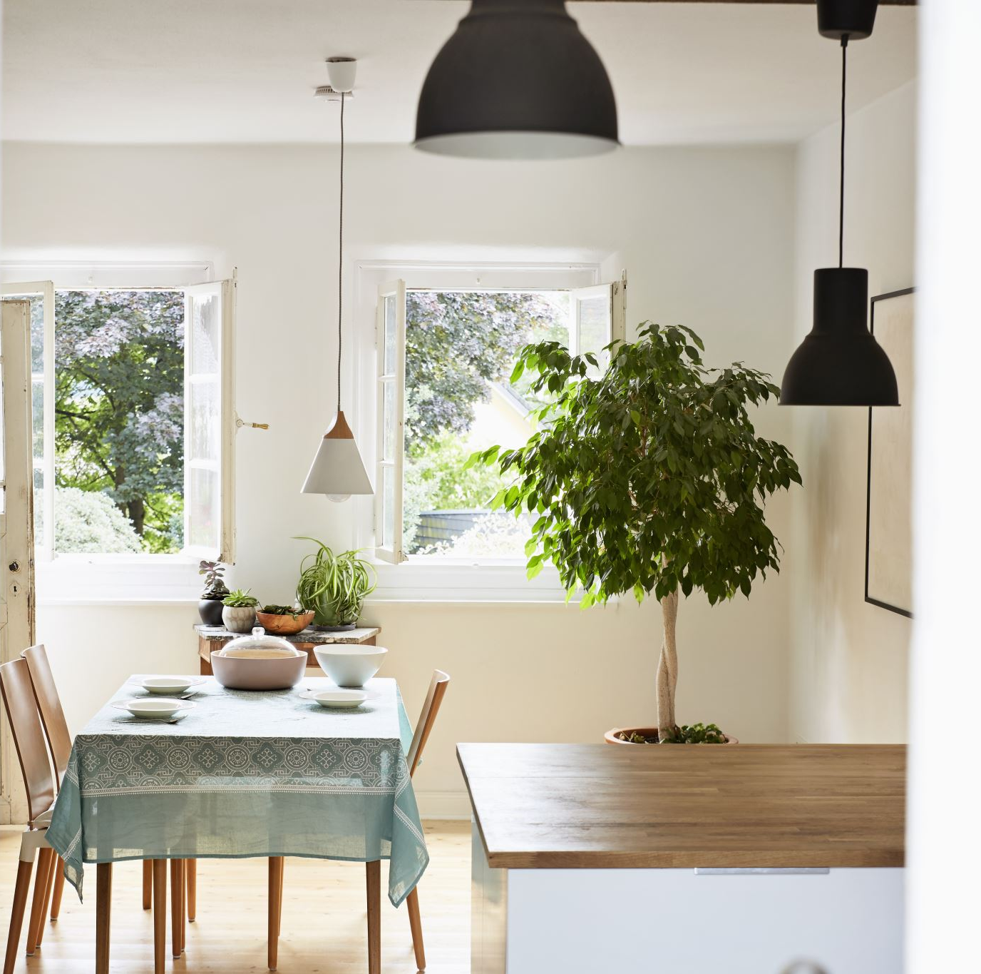

THANK YOU

